Slide 1
A PRESENTATION ON
Analog System Design
By
Nirvan Tamhane (D007)
(B.TECH Electronics and Telecommunication Engg., Sem XI)
Under the guidance of
Internal Mentor
Prof. Priyanka Verma
(Professor, EXTC Department, MPSTME)
Industry Mentors
Mr. Naveen M. Kumar
(Senior Manager, Takshila Institute of VLSI Technologies)

Slide 2
Contents
About the Organization
Introduction
Project Description
Software Description
Hardware Description
Implementation
Project Plan
Challenges
Learnings and Experience
References

Slide 3


About the Organization
Takshila Institute of VLSI Technologies
Focus: Very Large-Scale Integration (VLSI) industry.
Industry Sectors: Digital, Analog, and Mixed Signal IC Designs.
Specialization: Primarily digital design, with dedicated analog and mixed signal design teams.
Internship Training Programs:
First-hand VLSI design and implementation experience.
Privileged interactions with top-tier company executives.

Slide 4
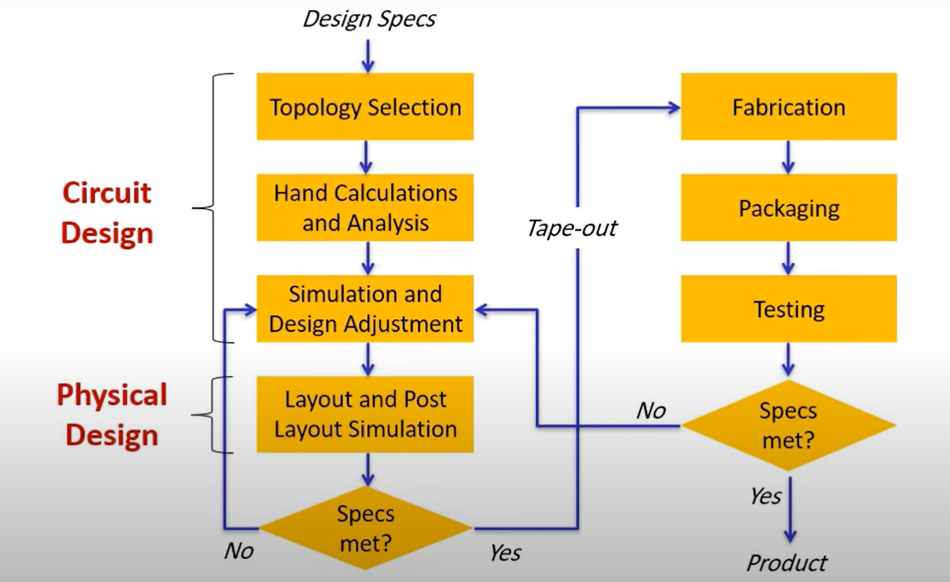
Introduction
Analog IC Design Flow:

Slide 5
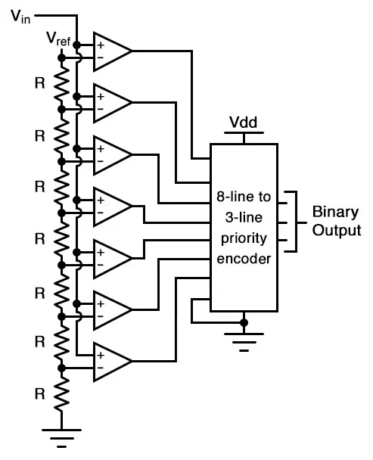
Introduction
Analog System Design:
Aims at developing an 8-bit Flash Analog to Digital Converter System.
Utilizes components such as Opamps, Comparators, LDO Regulators, Bandgap References, and Oscillators.

Slide 6


Introduction
Analog System Design
Designed using the Cadence Virtuoso Design Suite.
Utilizes the gpdk045 library which supports 45nm technology node.
Developed in a Linux environment.

Slide 7
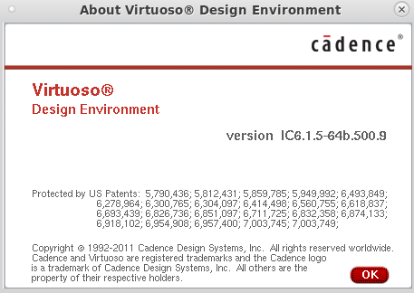
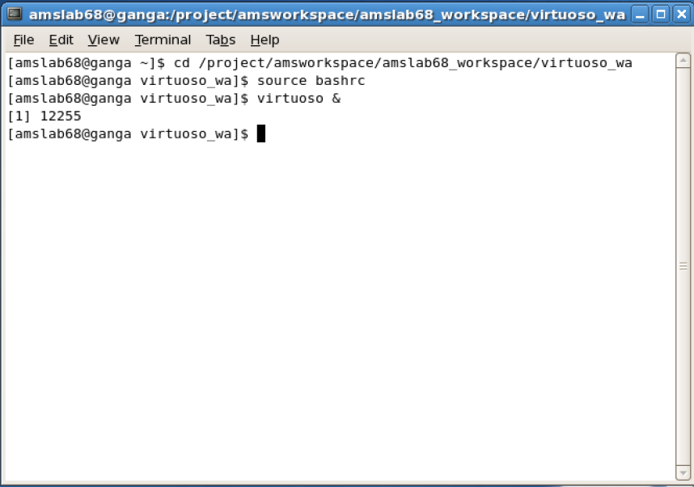
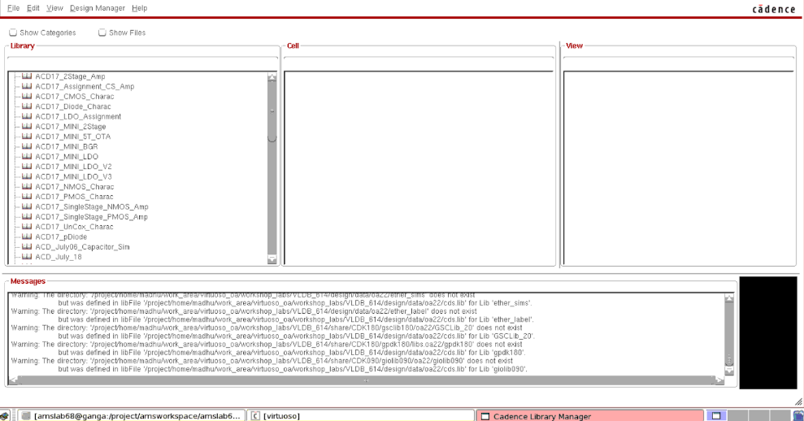
Project Description – Software Description
Cadence Virtuoso:
EDA tool for IC design.
Widely used in the semiconductor industry.
Supports digital, analog, and mixed-signal circuits.

Slide 8
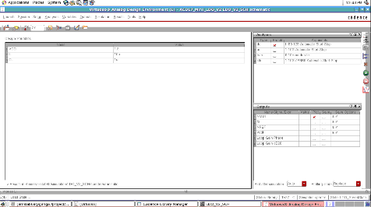
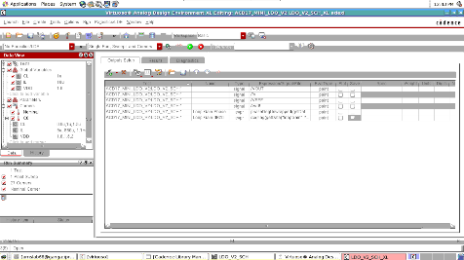
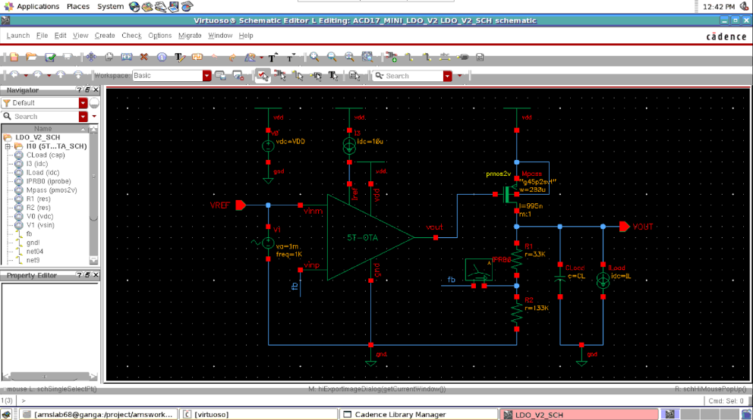
Project Description – Software Description
Cadence Virtuoso:
Intuitive interface for schematic capture, simulation, and layout.
Versatile and preferred for cutting-edge semiconductor device design.

Slide 9
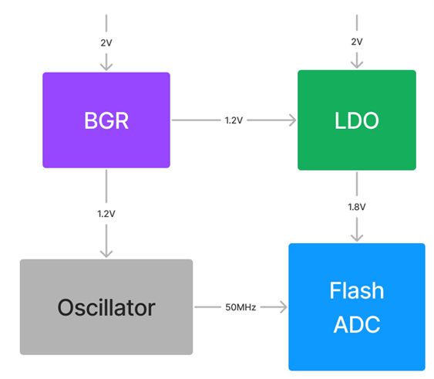
Project Description – Hardware Description
Components:
Low Dropout (LDO) Regulator
Bandgap Reference (BGR) or Voltage Reference
Oscillator
Analog to Digital Converter

Slide 10

Implementation
Methodology:
Planning
Calculation of design parameters
Schematic design
Simulation and testing

Slide 11

Implementation
Planning:
Defining the specifications
Selecting the proper design methodologies
Selecting the circuit configurations and components to be utilized.
Considering the design trade-offs.

Slide 12
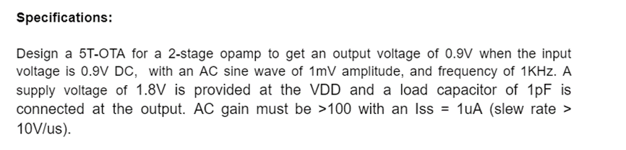
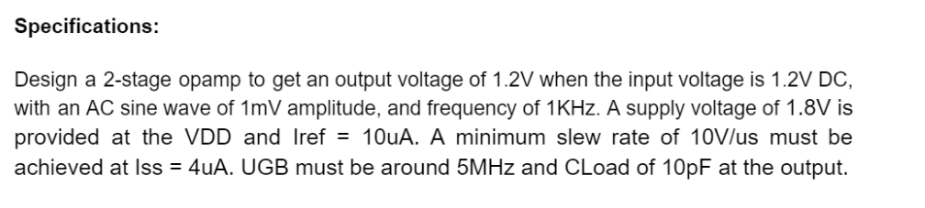
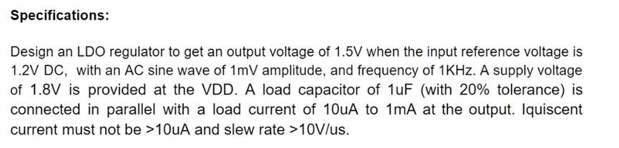
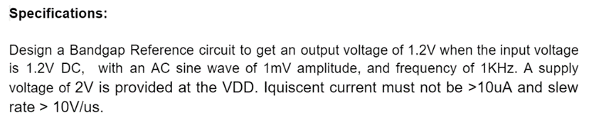
Implementation
Defining the Specifications:

Slide 13
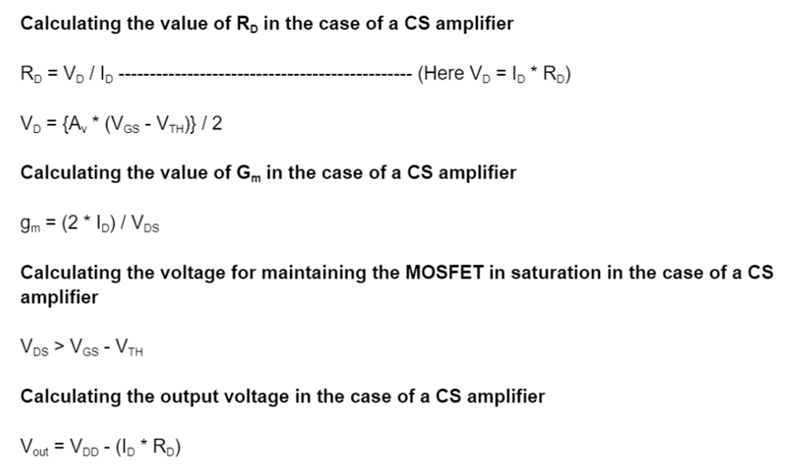
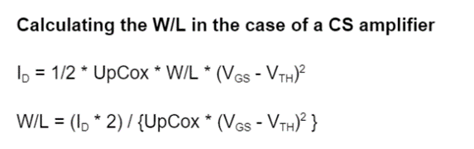
Implementation
Calculation of the design parameters:
Selecting the calculation methodology.
Selecting the assumptions in case of the hand calculations.
Neglecting some insignificant parameters.

Slide 14
Implementation
Procedure for calculating the design parameters: (Single-stage CS Amplifier)
Calculate the MOSFET overdrive voltage (V_{GS} - V_{T}).
Determine the µ_{n}C_{ox} and µ_{p}C_{ox} for MOSFETs using drain current I_{D}.
Calculate resistor values based on voltage at the drain terminal.
Estimate g_{m} and R_{out} of MOSFET for gain calculation.
Size the MOSFET by calculating W/L ratio to meet the drain current constraints.

Slide 15
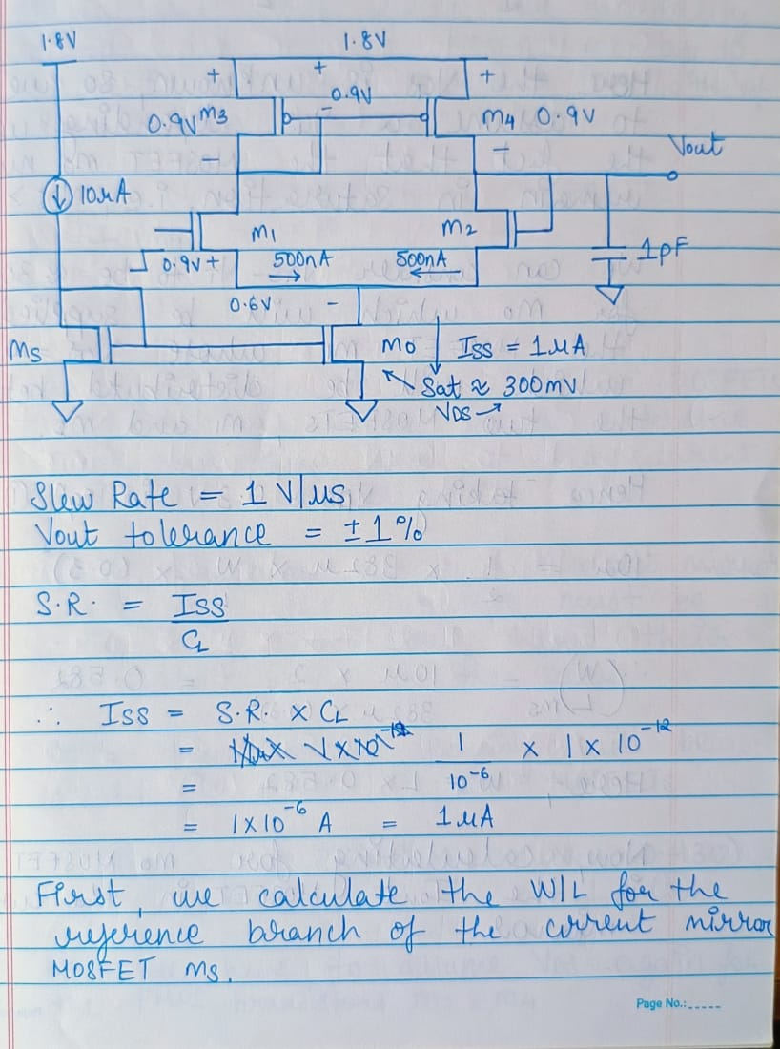
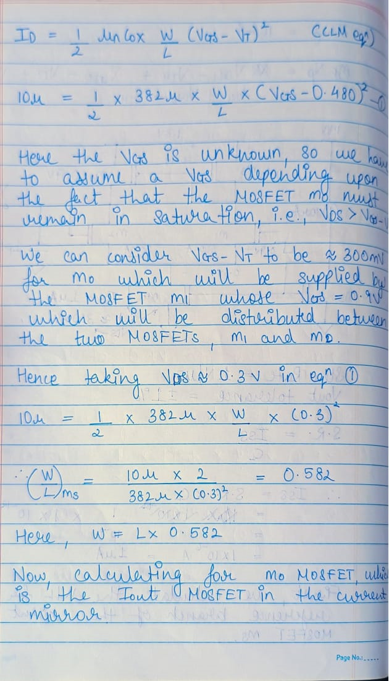
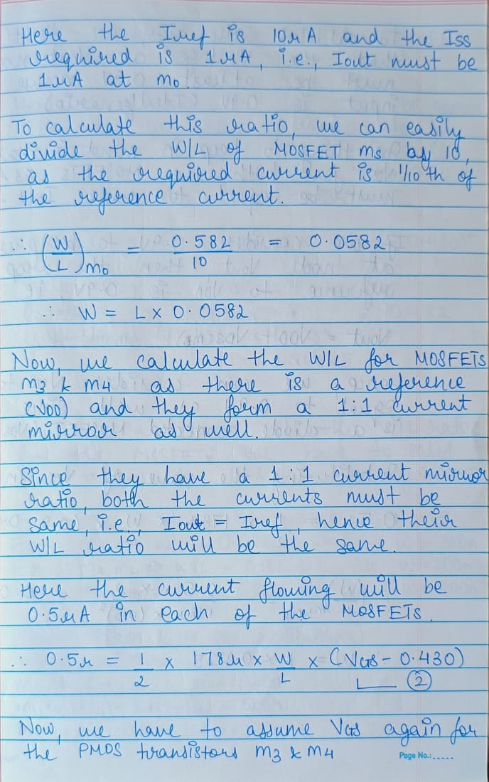
Implementation
Calculation of the design parameters (Hand Calculations)

Slide 16
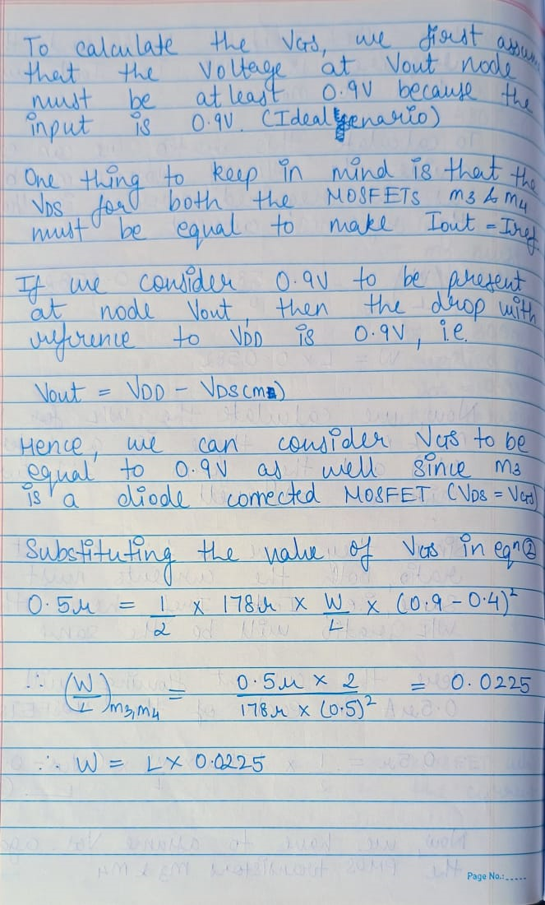
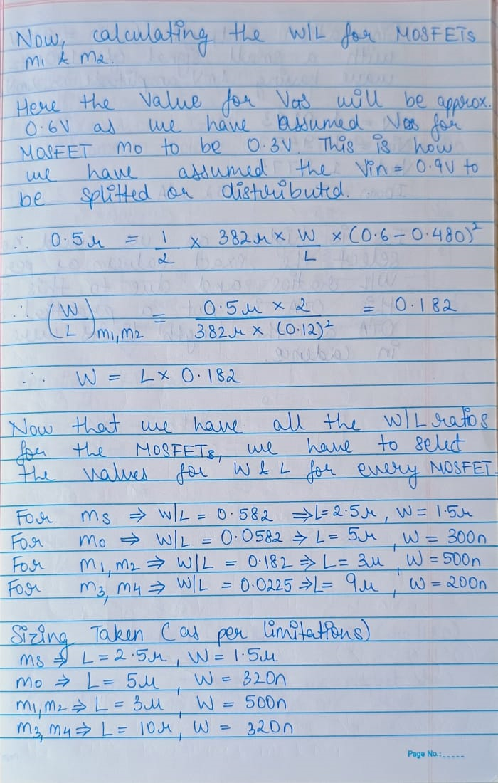
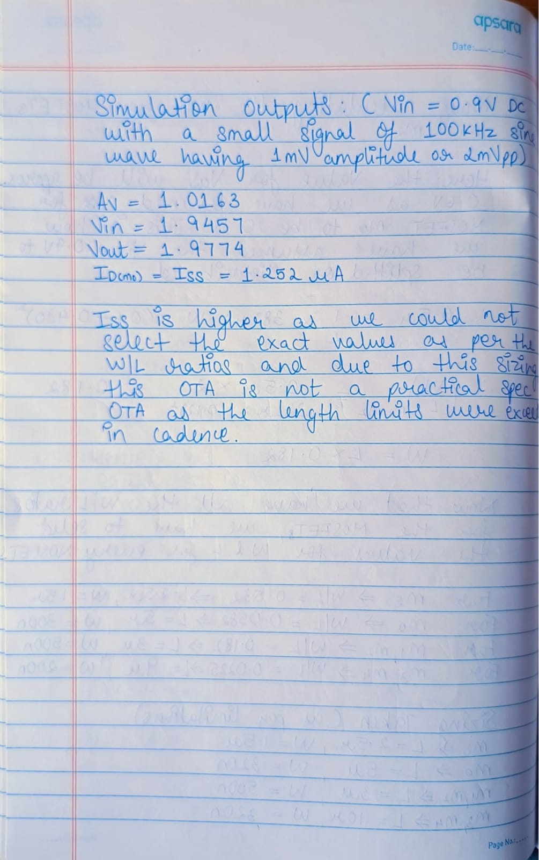
Implementation
Calculation of the design parameters (Hand Calculations)

Slide 17
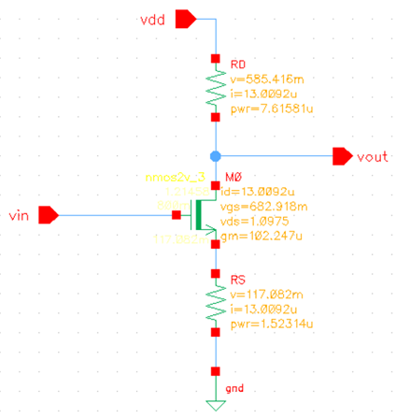
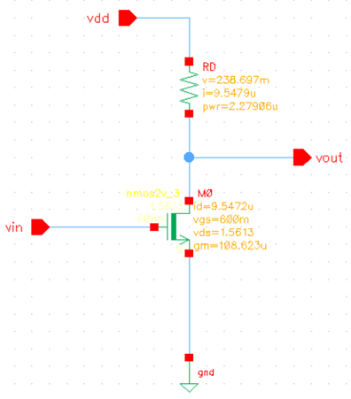
Implementation
Schematic Design for Single-Stage NMOS CS Amplifier and CSSD Amplifier

Slide 18
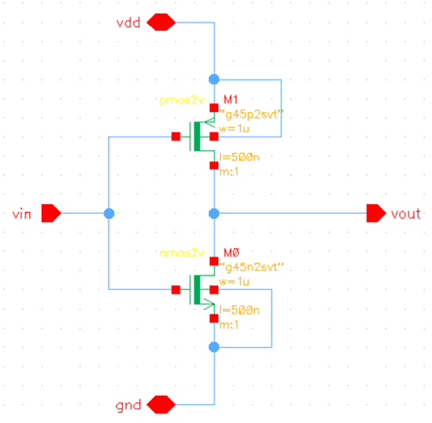
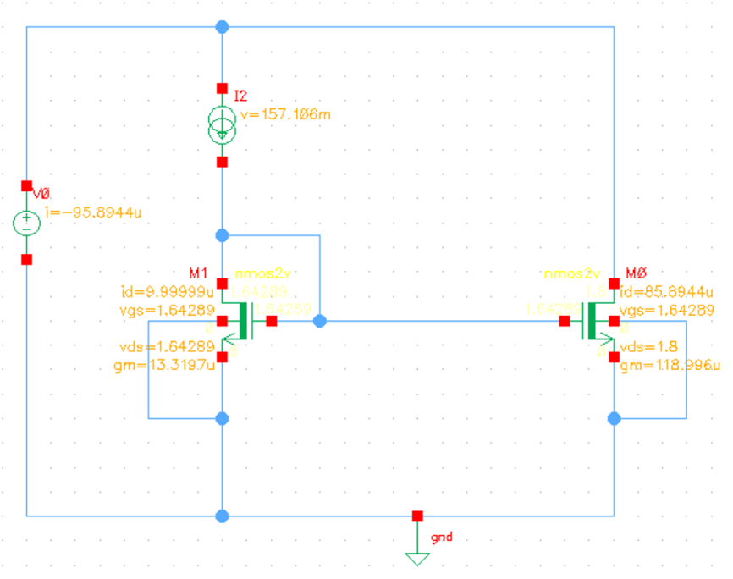
Implementation
Schematic Design for a CMOS Inverter and NMOS Current Mirror

Slide 19
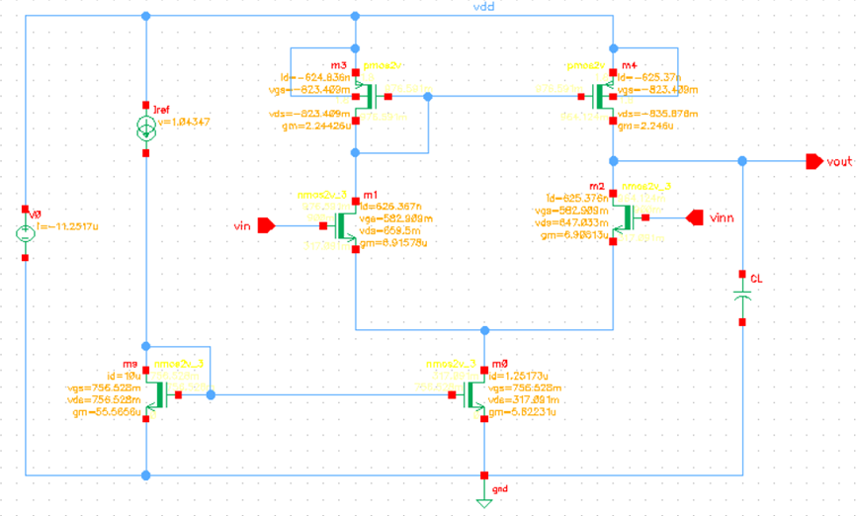
Implementation
Schematic Design for a 5-Transistor Operational Transconductance Amplifier

Slide 20
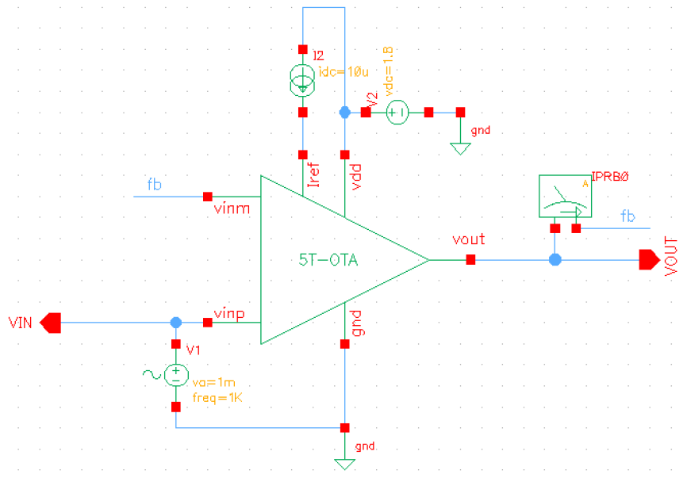
Implementation
Schematic Design for a 5-Transistor OTA Testbench

Slide 21
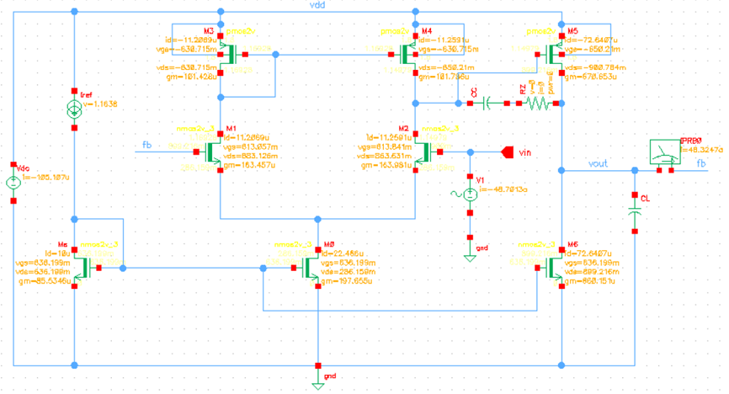
Implementation
Schematic Design for a 2-Stage Operational Amplifier

Slide 22
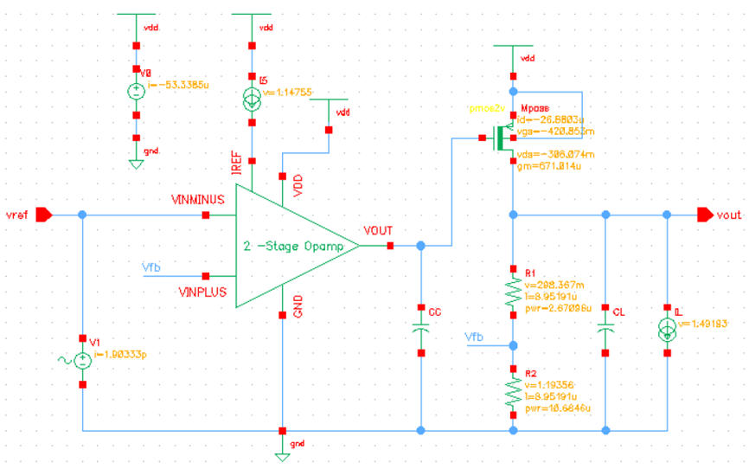
Implementation
Schematic Design for a Low Dropout (LDO) Regulator using a 2-Stage Opamp

Slide 23
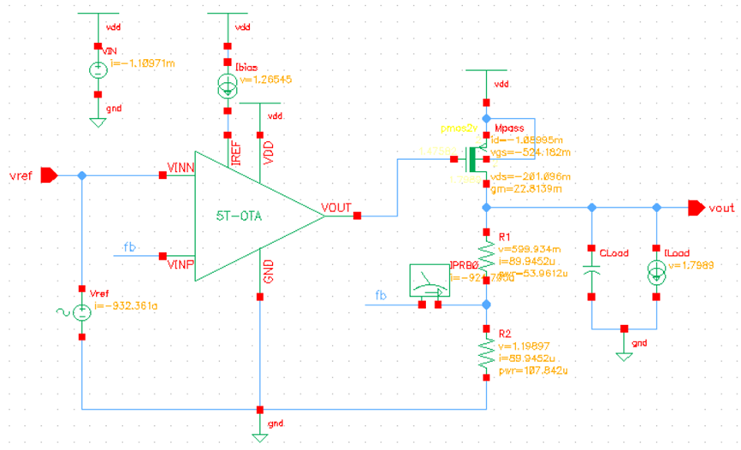
Implementation
Schematic Design for a Low Dropout (LDO) Regulator using a 5T-OTA

Slide 24
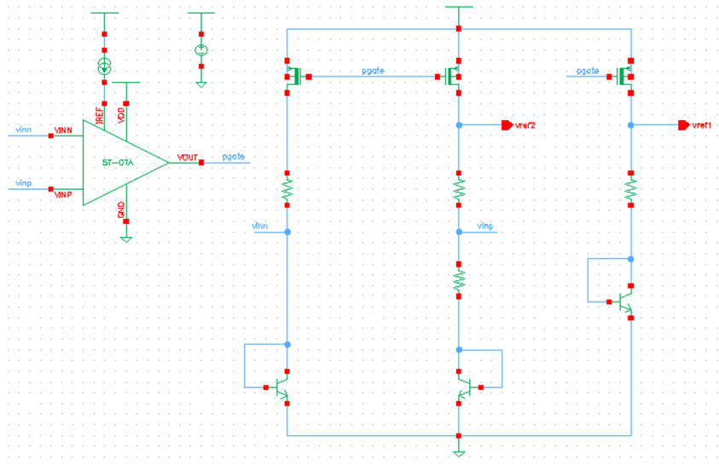
Implementation
Schematic Design for a Bandgap Reference (BGR) using a 5T-OTA and BJTs

Slide 25
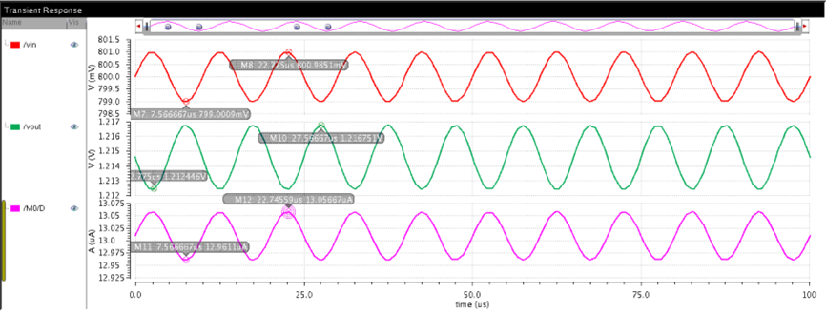
Implementation
Transient Simulation for a CSSD Amplifier (Vin, I_{D} & Vout)

Slide 26
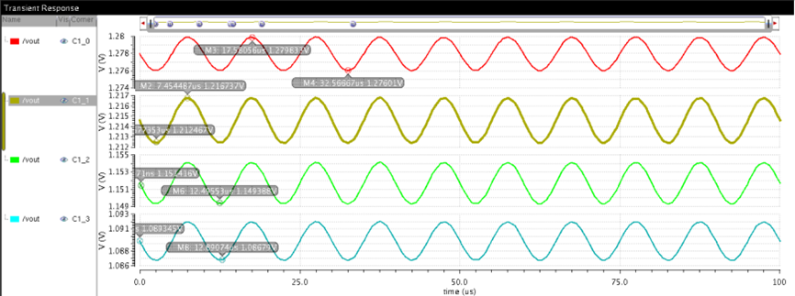
Implementation
Transient Simulation for a CSSD Amplifier (Vout for different R_{D} values)

Slide 27
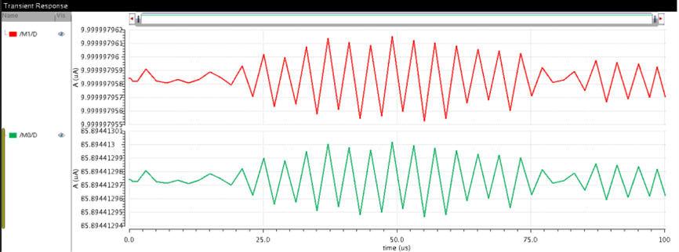
Implementation
Transient Simulation for a Current Mirror (I_{REF} & I_{OUT})

Slide 28
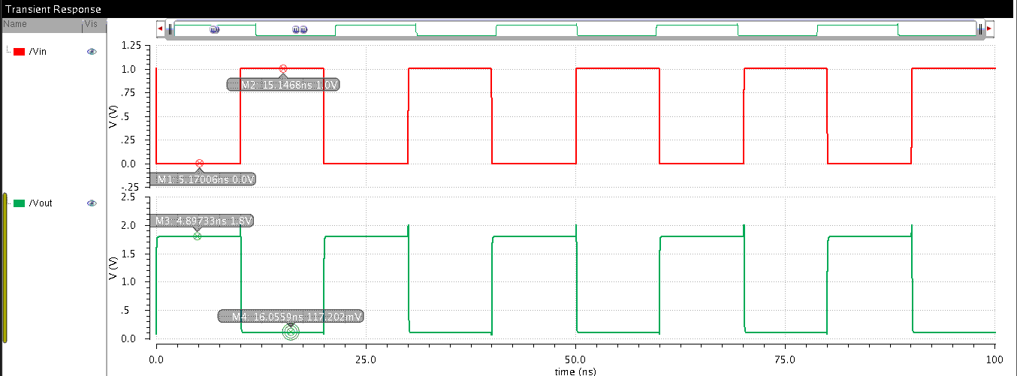
Implementation
Transient Simulation for a CMOS Inverter (Vin & Vout)

Slide 29
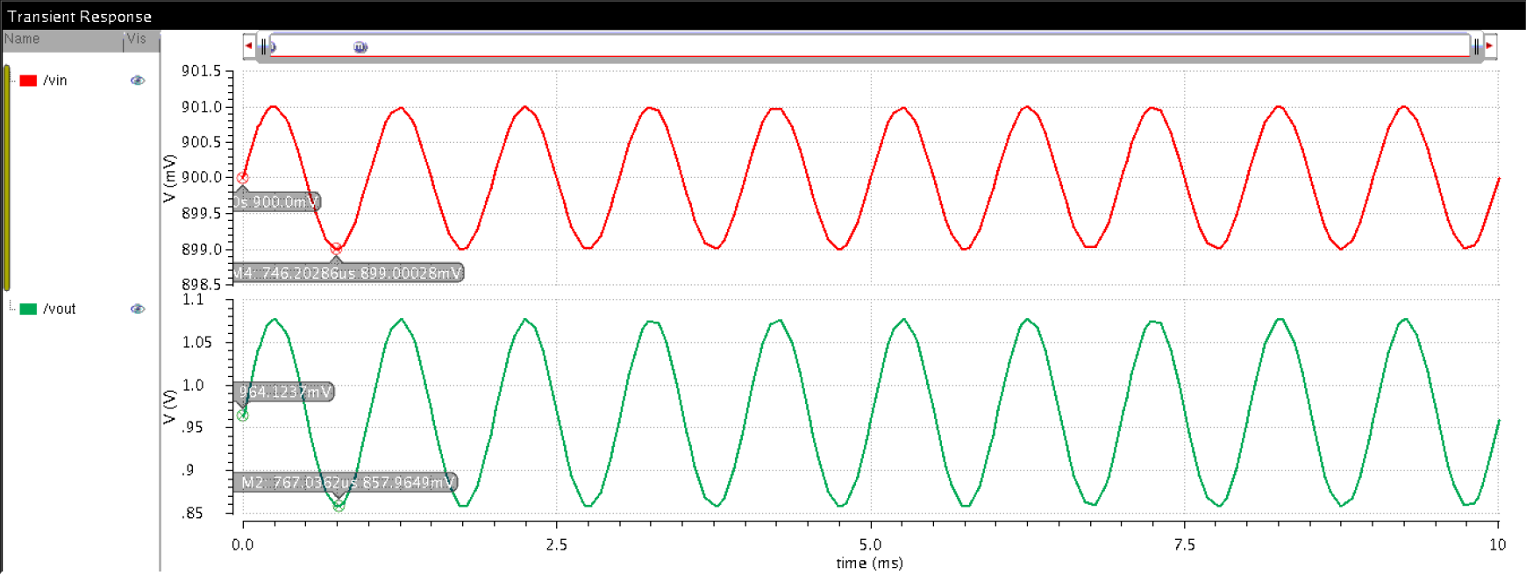
Implementation
Transient Simulation for a 5T-OTA (Vin & Vout)

Slide 30
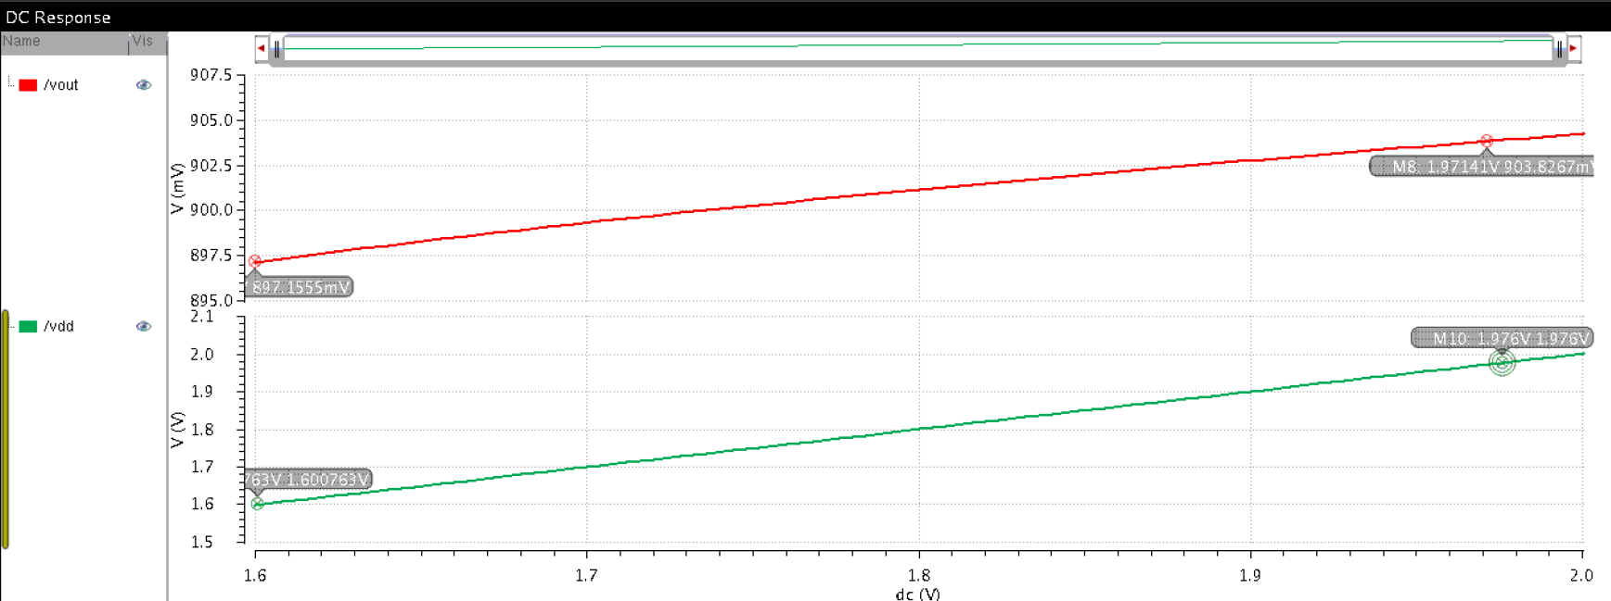
Implementation
DC Simulation for a 5T-OTA (V_{DD} & Vout)

Slide 31
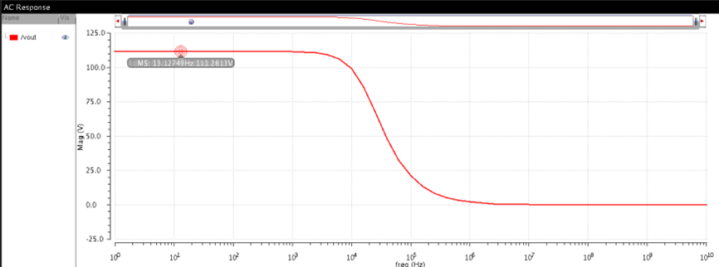
Implementation
AC Simulation for a 5T-OTA (Vout)

Slide 32
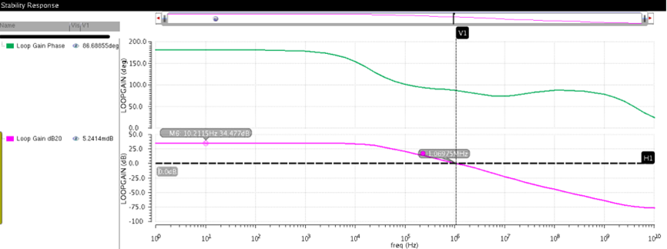
Implementation
Stability Response Simulation for a 5T-OTA

Slide 33
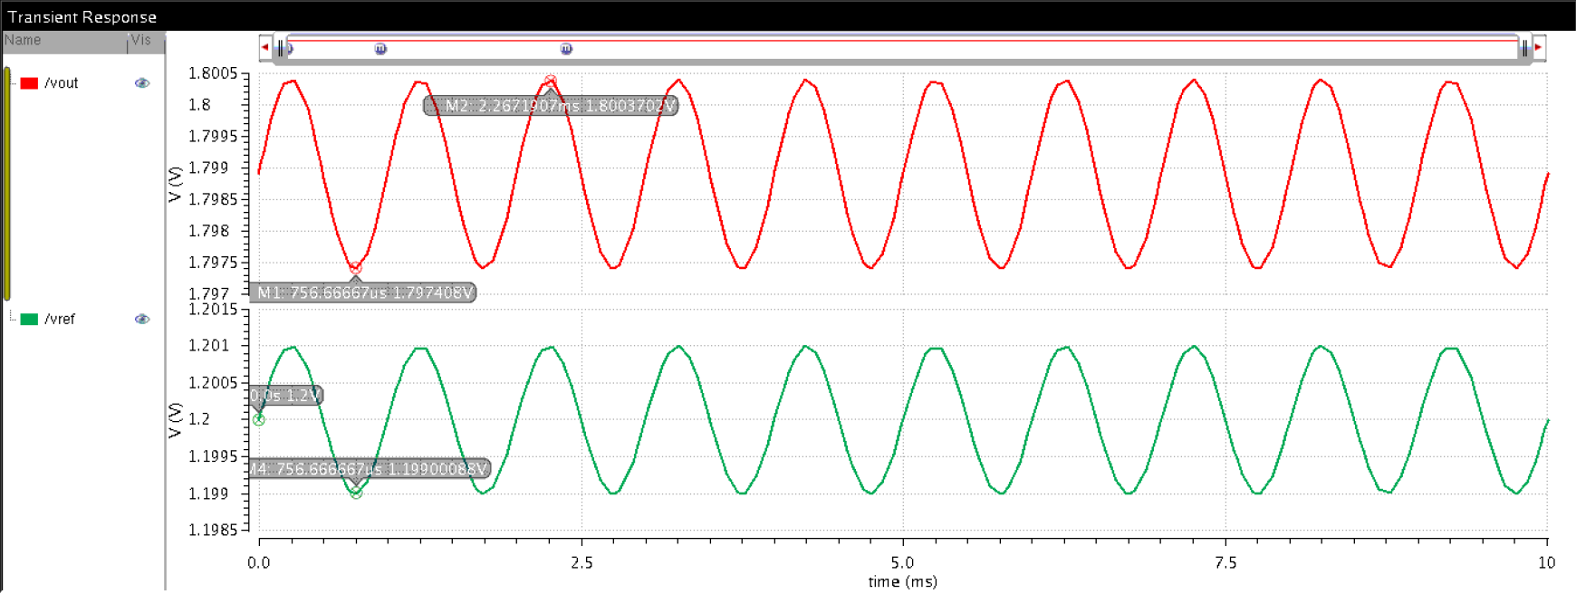
Implementation
Transient Simulation for an LDO using a 5T-OTA (Vin & Vout)

Slide 34
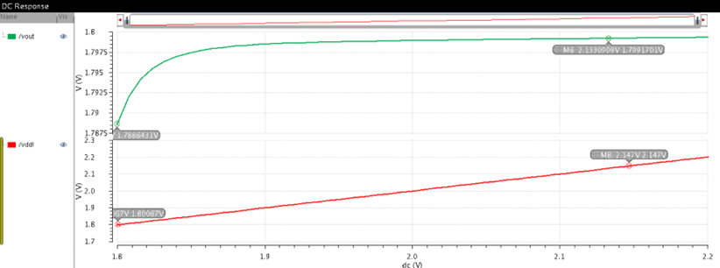
Implementation
DC Simulation for an LDO using a 5T-OTA (V_{DD} & Vout)

Slide 35
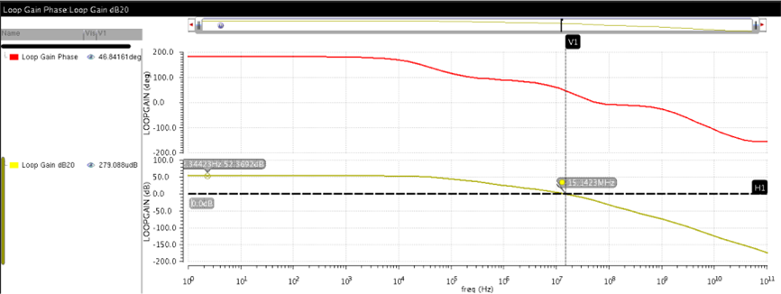
Implementation
Stability Response Simulation for an LDO using a 5T-OTA

Slide 36
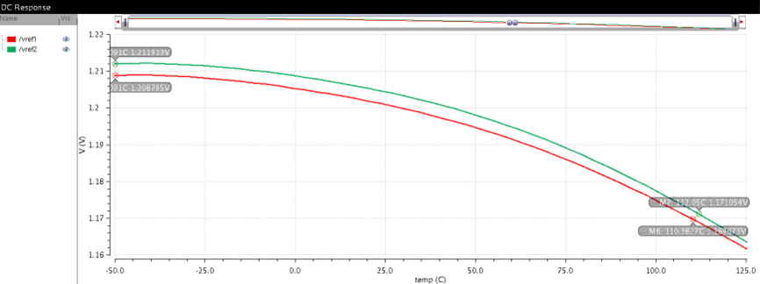
Implementation
DC Simulation for a BGR (CTAT & PTAT)

Slide 37
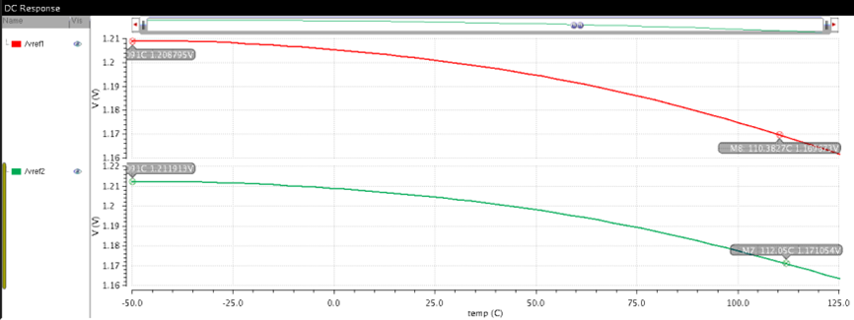
Implementation
DC Simulation for a BGR (Temperature sweep)

Slide 38

Project Plan
Steps involved:
Planning the architecture and specifications
Calculating the values for the design variables
Designing the schematic
Simulating and Testing the design

Slide 39

Challenges
The 5 main challenges faced were:
Noise and Sensitivity Management
Process-Voltage-Temperature (PVT) Corner Variations
Stability and Bandwidth trade-offs
Power consumption optimization

Slide 40
Learnings and Experience
Deep Understanding of Analog Principles
Circuit Design Techniques
Technology and Process Understanding
Simulation and Modelling Skills
Regulatory Compliance Awareness
Analog IC Design, Control Systems, and Signals and Systems.

Slide 41
References
Analog IC Design Flow by Dr. Hesham Omran
Cadence Virtuoso ADE Suite

Slide 42
Thank you

Slide 43
Questions?

